Slide 1

E3-258 Design for IoT Intrusion Detection System
Kirteyman Rajput
Sarvjit Ajit Patil

Slide 2
Challenges:
Scope:
To detect intrusion in specific area.
Alert the concerned person.
Capturing signals with multiple sensors.
Size, cost and power requirements.
Choosing the right sensors.

Slide 3
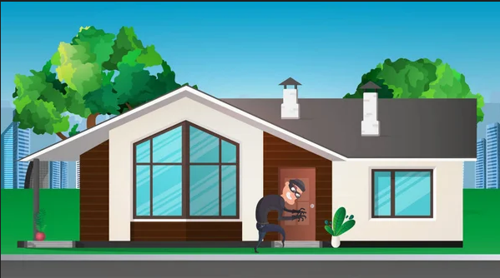
Applications:
Home Security
Intruder alert in exhibitions, jewellery shops, industries.
Perimetral Security.

Slide 4
System Design

Slide 5
Choosing the Sensor:
We want to detect vibrations and pressure sensitivity
Even smallest amplitude signal – high sensitivity and resolution.
In any environment e.g. sun, dark, fog, dust, temperature
With minimum power consumption.
With small form factor.

Slide 6

Pressure-Sensitive Conductive Sheet( Velostat ):
Dimensions: 11" x 11" (280mm x 280mm)
4 mil / 0.1mm thick
Weight: 18.66g
Temperature Limits : -45°C to 65°C (-50°F to 150°F)
Volume Resistivity : <500 ohm-cm
Surface Resistivity : < 31,000 ohms/sq.cm
Why?
More area coverage with more matrix connections.
Doesn’t break on applying pressure (flexible).
High sensitivity.

Slide 7
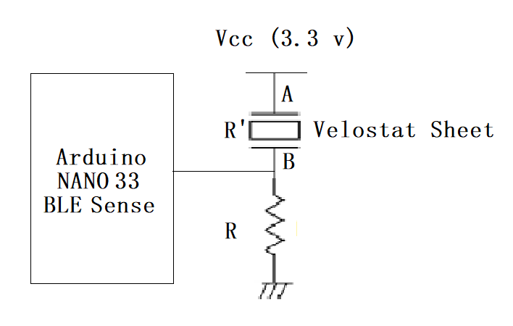
Interfacing Velostat sheet
Challenges:
Taking connections to interface with microcontroller.
Choosing resistor R.

Slide 8
Implementation Plan

Slide 9
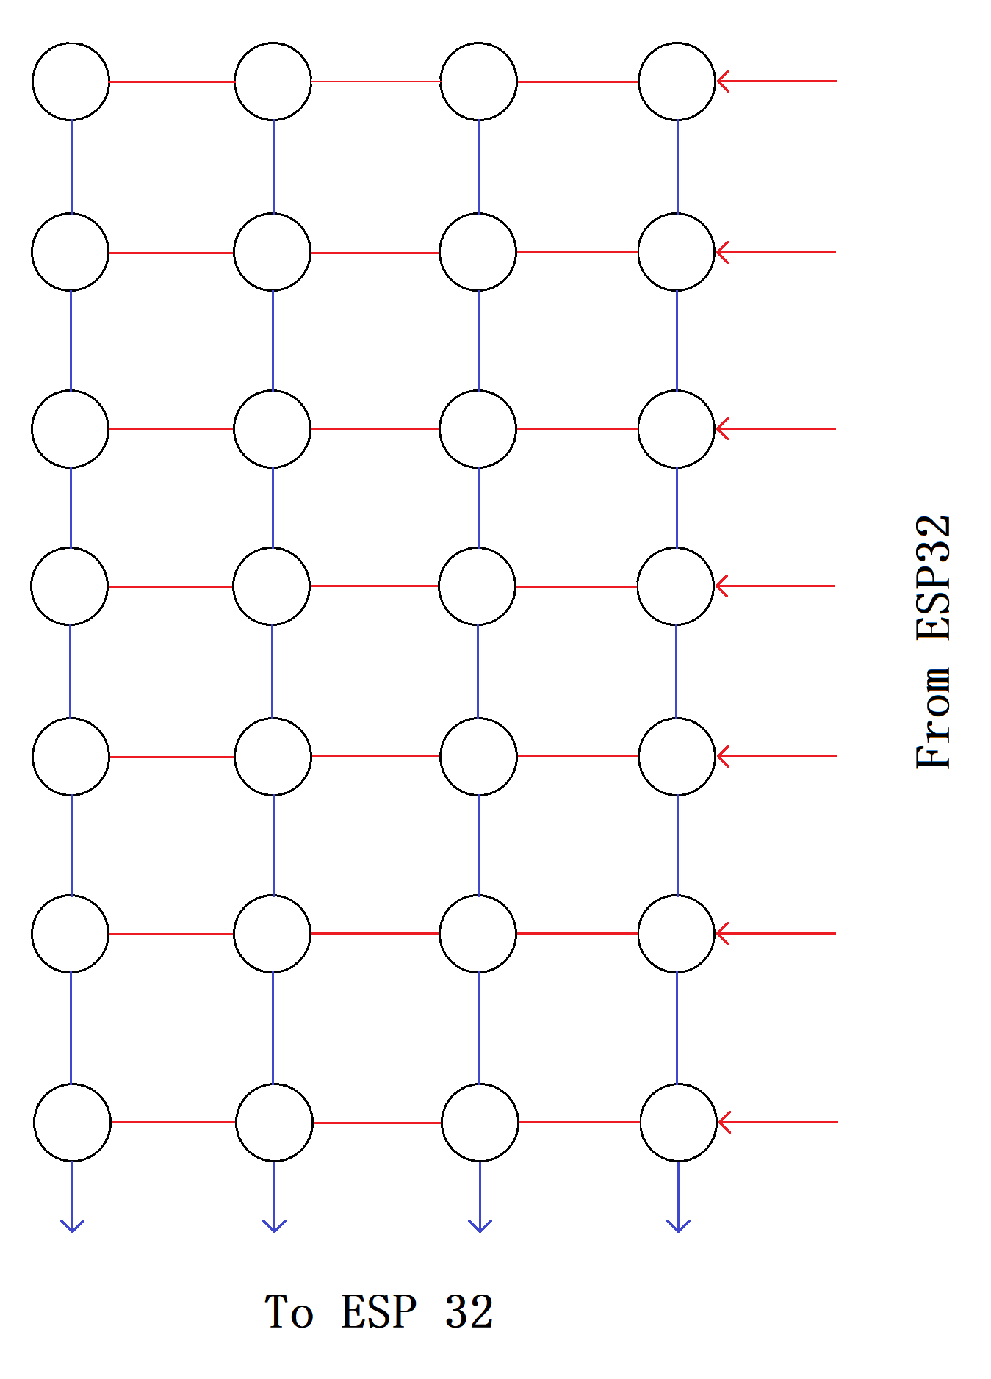
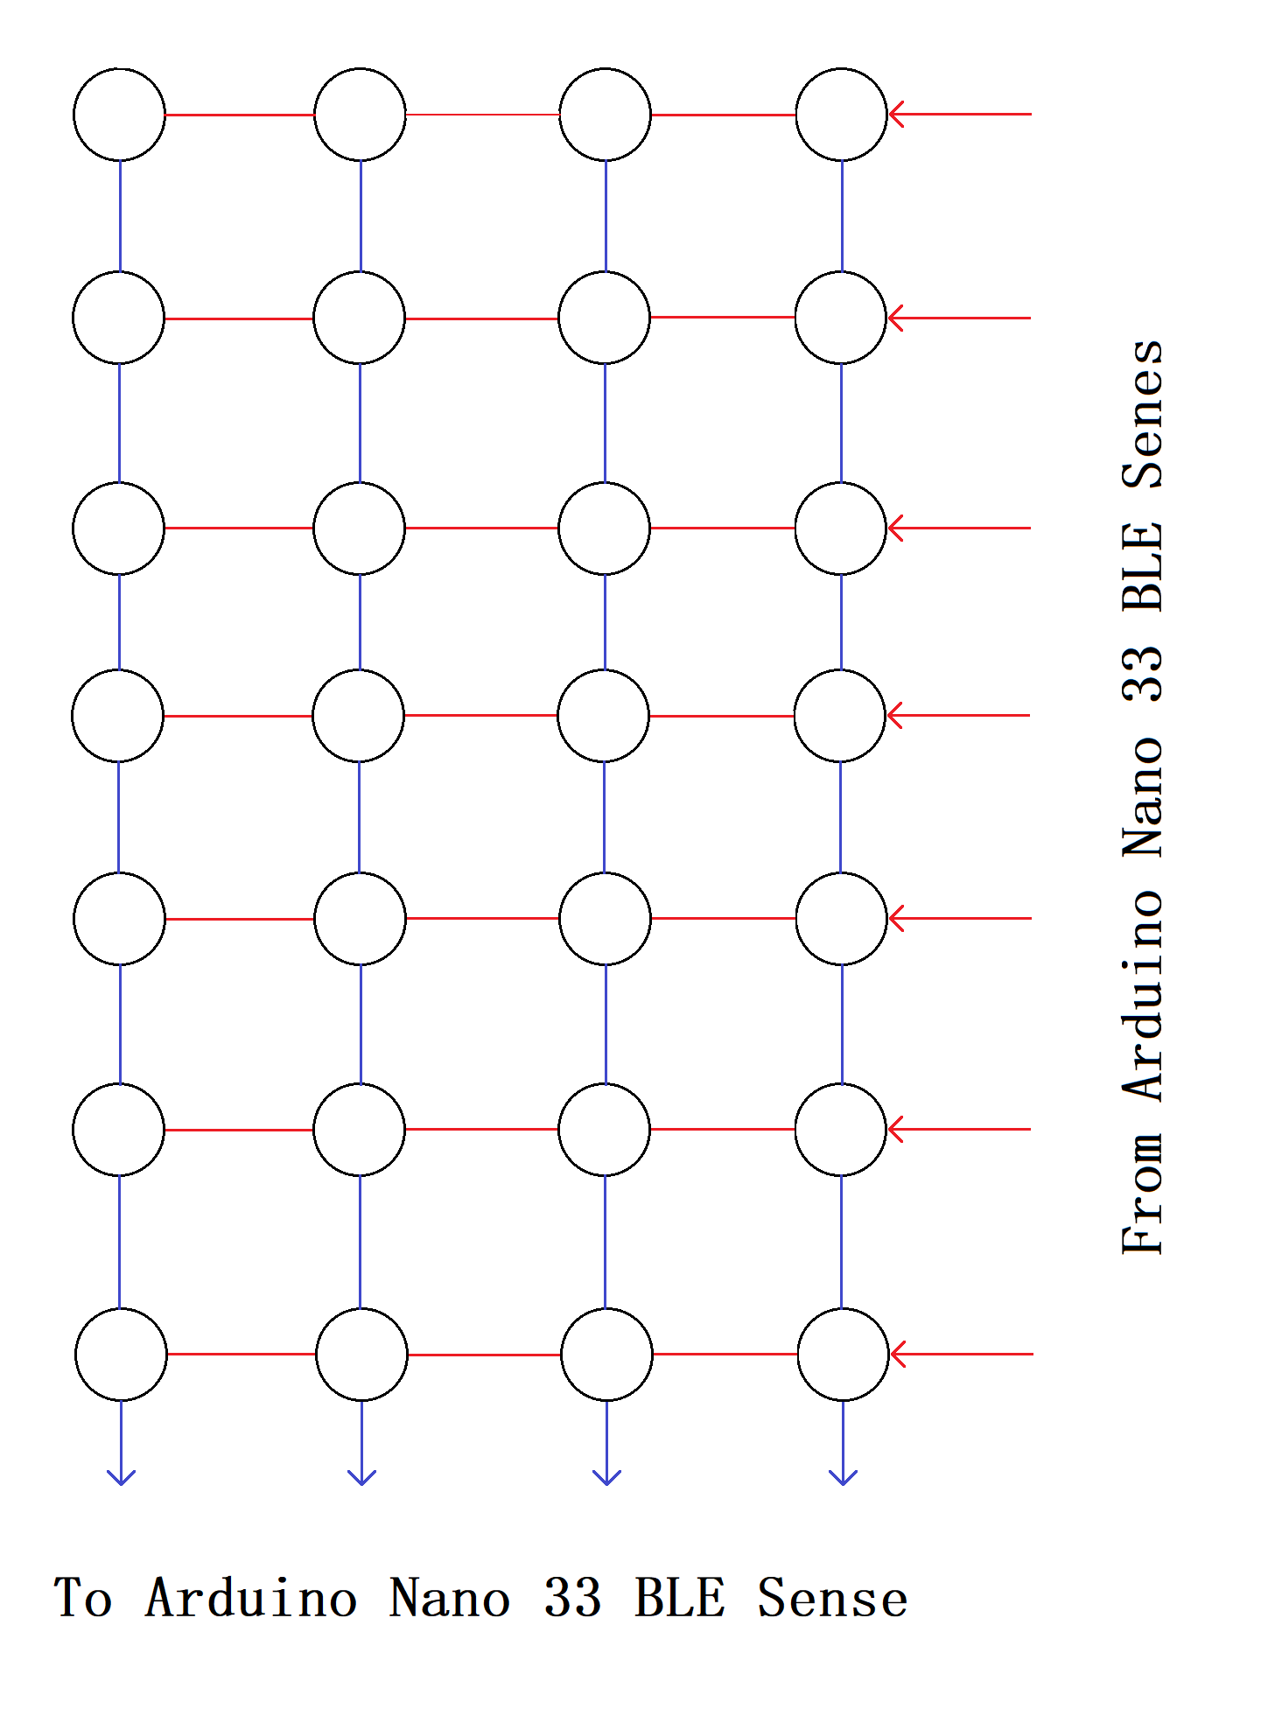
Matrix Multiplexing allows coverage of more area with less GPIOs.
Write HIGH to each column and read each row at a time.
- Same as keypad matrix

Slide 10
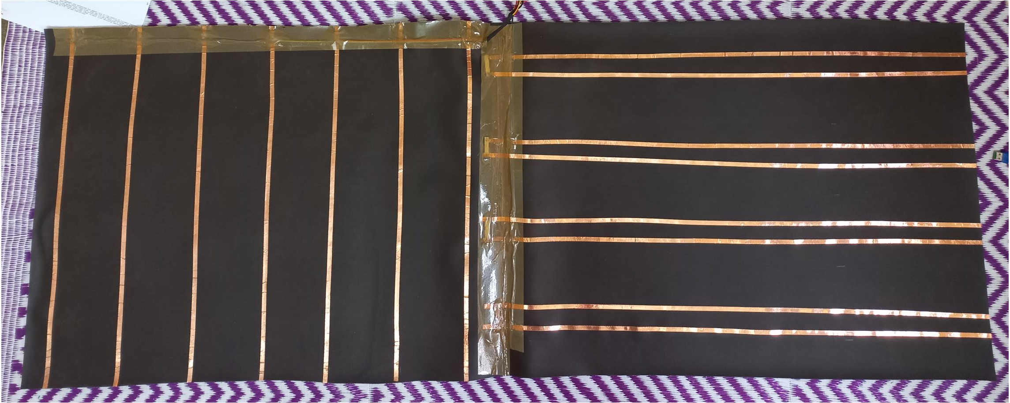
Fig. Seat cover fabric with copper tapes sticked.

Slide 11
Engineering and Software Layout

Slide 12
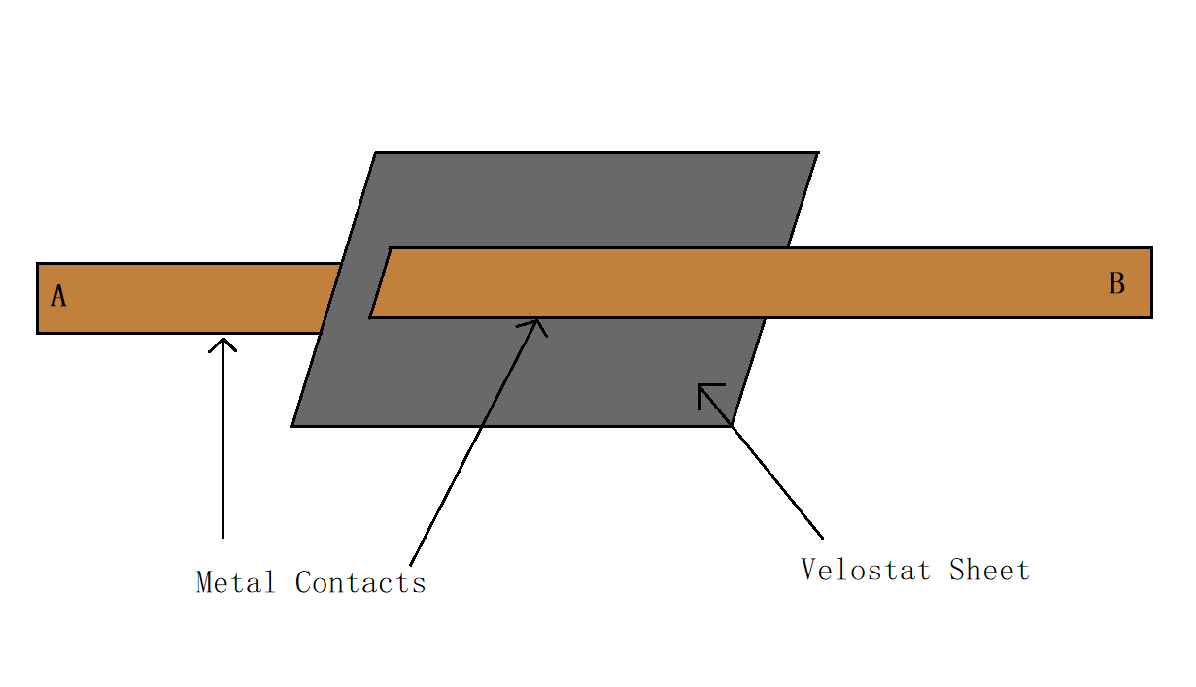
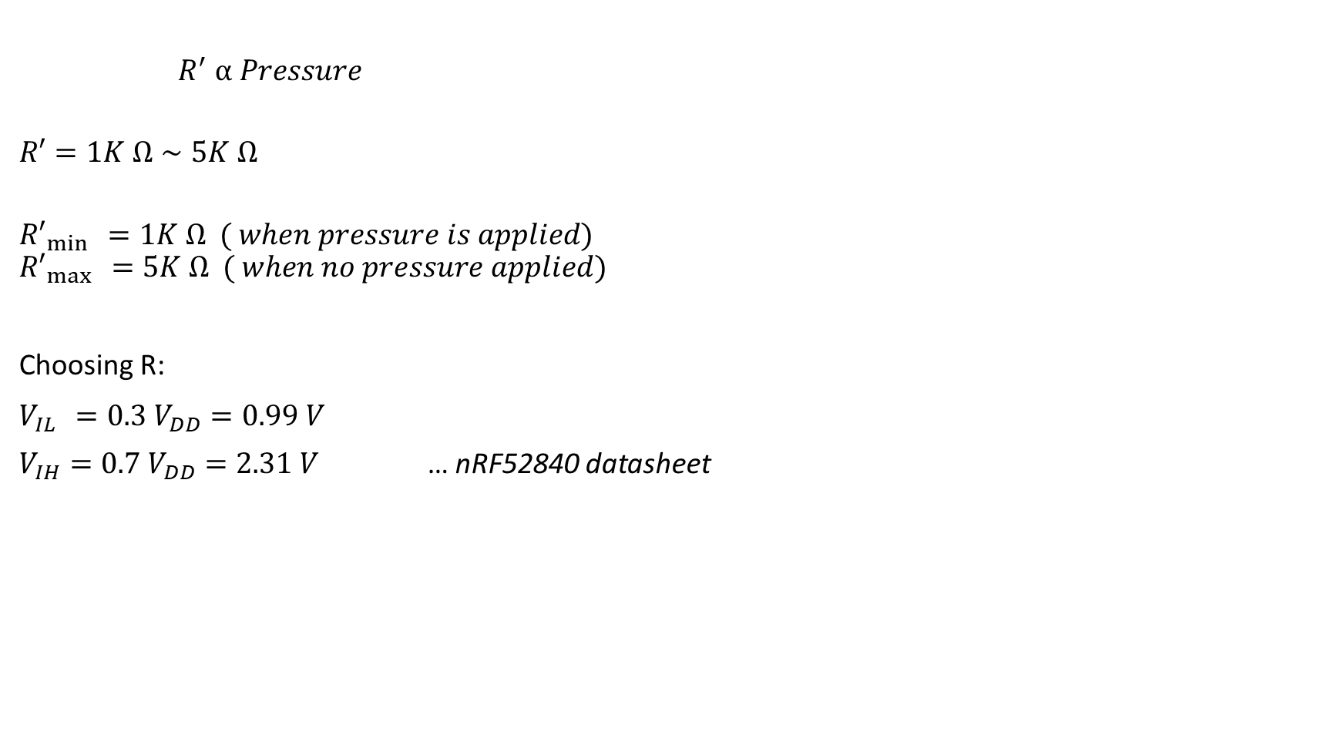
Interfacing Velostat:
$R^{′} ⍺ Pressure$
$$R′=1K Ω∼5K Ω$$
$${R′}_{\min{ }}=1K Ω ( when pressure is applied)$$
$${R′}_{\max{ }}=5K Ω ( when no pressure applied)$$
Choosing R:
$V_{\operatorname{IL}{ }}=0.3 V_{DD}=0.99 V$
$V_{IH}=0.7 V_{DD}=2.31 V$ … nRF52840 datasheet
$$V_{\operatorname{IL}{ }}=0.25 V_{DD}=0.825 V$$
$V_{IH}=0.75 V_{DD}=2.475 V$ … ESP32 datasheet
Fig. Adding connections to velostat.
Fig. Interfacing velostat to microcontroller.

Slide 13
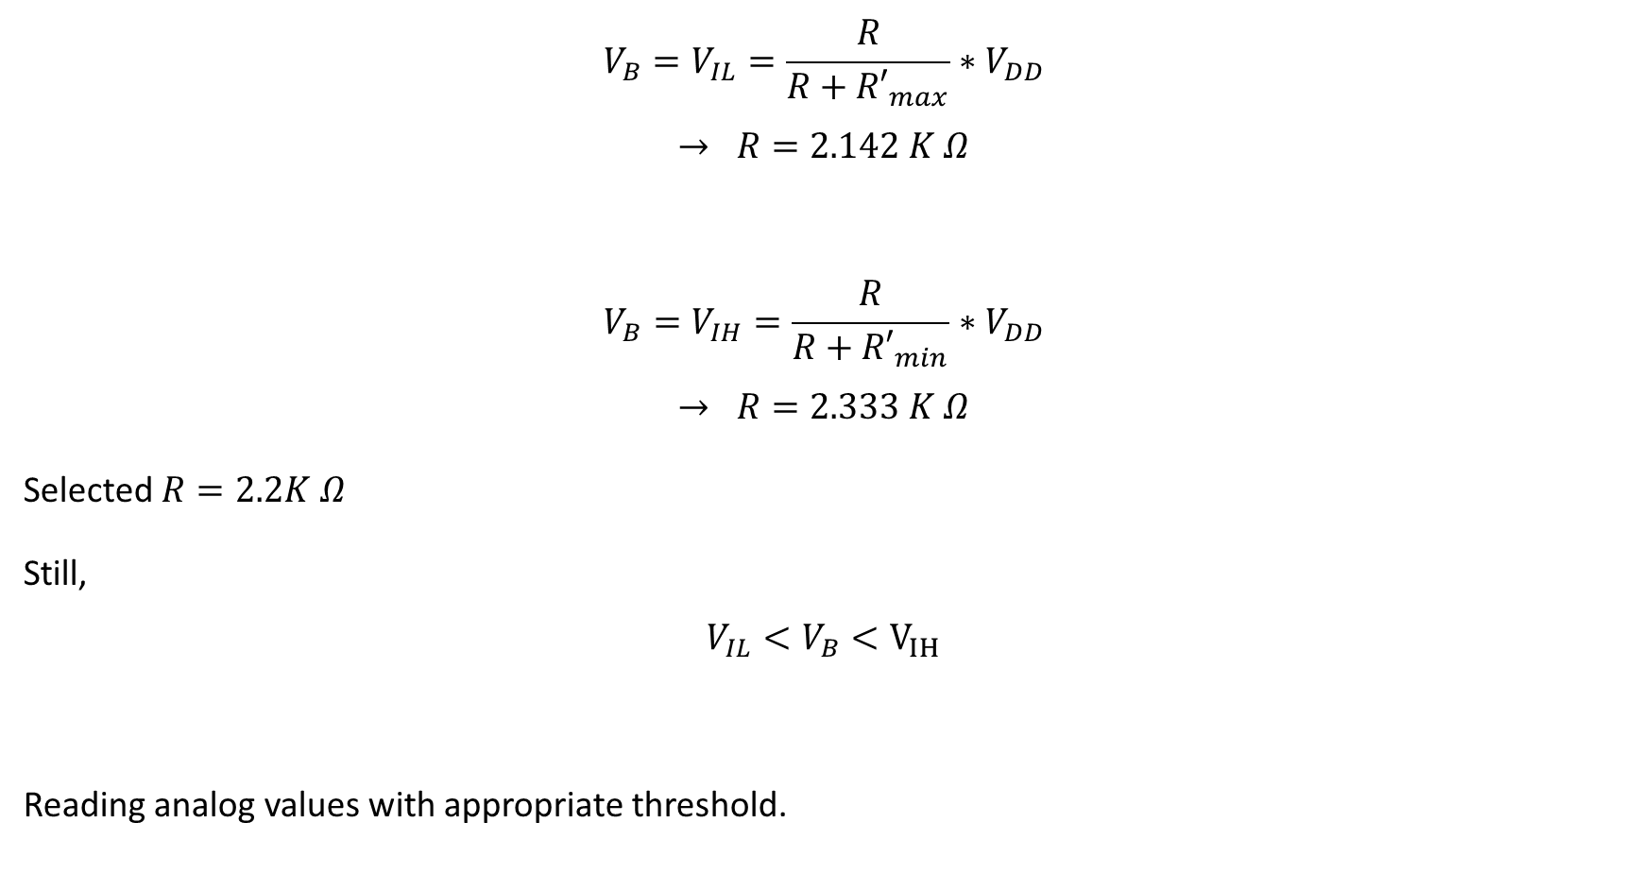
$$V_{B}=V_{IL}=\frac{R}{R+{R′}_{max}}∗V_{DD}$$
$$→ R=2.142 K Ω$$
$$V_{B}=V_{IH}=\frac{R}{R+{R′}_{min}}∗V_{DD}$$
$$→ R=2.333 K Ω$$
Selected $R=2.2K Ω$
Still,
$$V_{IL}<V_{B}<V_{IH}$$
Reading analog values with appropriate threshold.

Slide 14
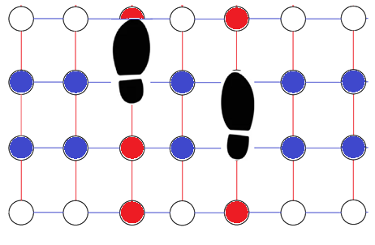
Detecting Human Steps
Adjusted node positions such that two of them will give sufficiently high signal.
while (1) :
Read nodes sequentially;
Check whether a node has crossed threshold?
If yes :
check its nearby nodes (only above and below will work in this case)
If any of these crossed threshold :
human step is detected
else :
nop

Slide 15
Algorithm:
ESP32_Modem -> ON
Send init message
ESP32_Modem -> OFF
while (1) :
read all nodes
check with the auth_key
if true:
Authentication successful
ESP32_Modem -> ON
send a message to the user via Telegram
ESP32_Modem -> OFF
else:
Authentication failed
ESP32_Modem -> ON
send a message to the user via Telegram
ESP32_Modem -> OFF

Slide 16
Read nodes sequentially;
Check whether a step is detected?
If yes :
ESP32_Modem -> ON
send a message to the user via Telegram
ESP32_Modem -> OFF
else :
nop

Slide 17
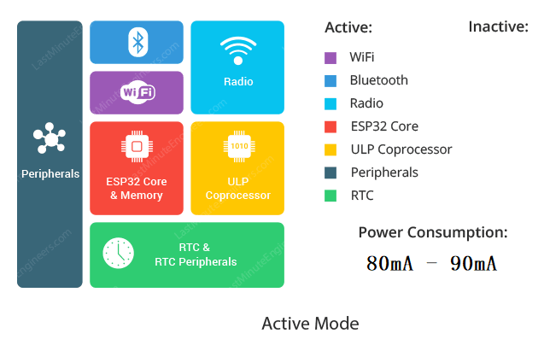
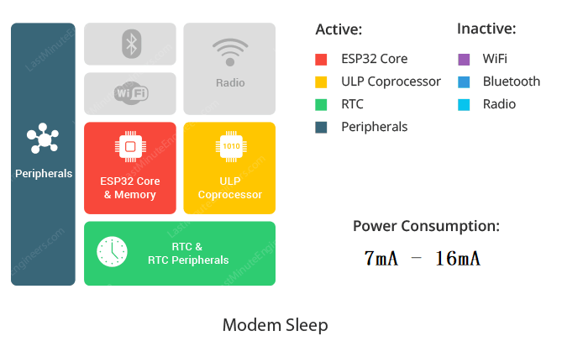
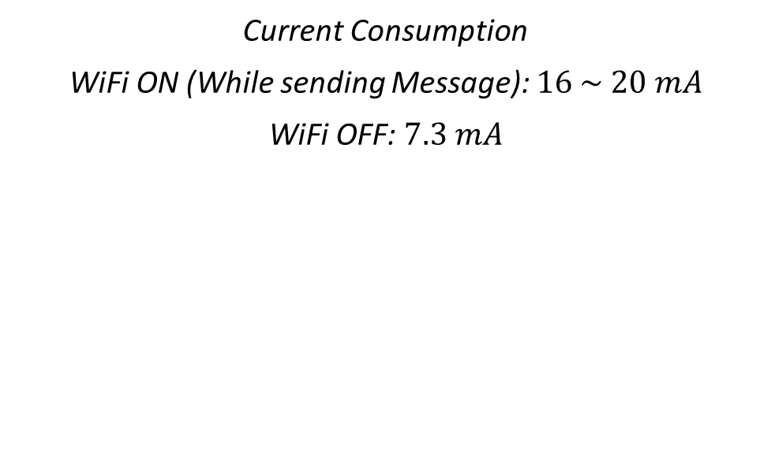
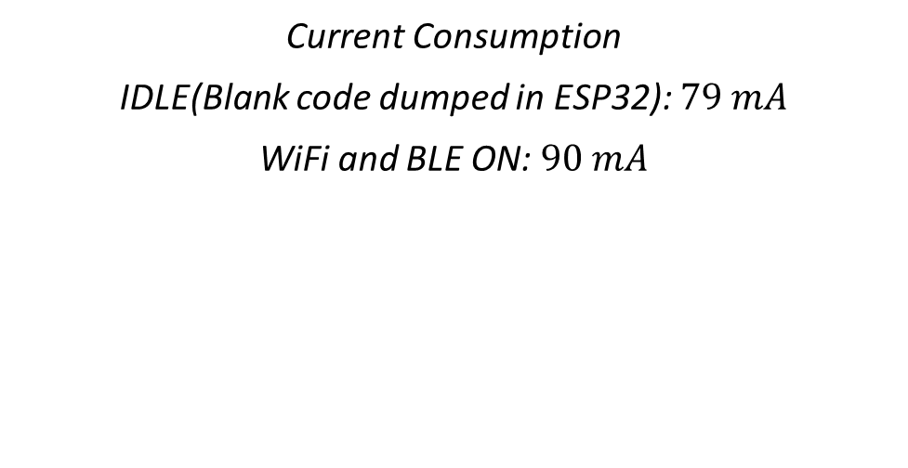
Low Power Mode
Current Consumption
IDLE(Blank code dumped in ESP32): $79 mA$
WiFi and BLE ON: $90 mA$
Current Consumption
WiFi ON (While sending Message): $16 \sim 20 mA$
WiFi OFF: $7.3 mA$

Slide 18
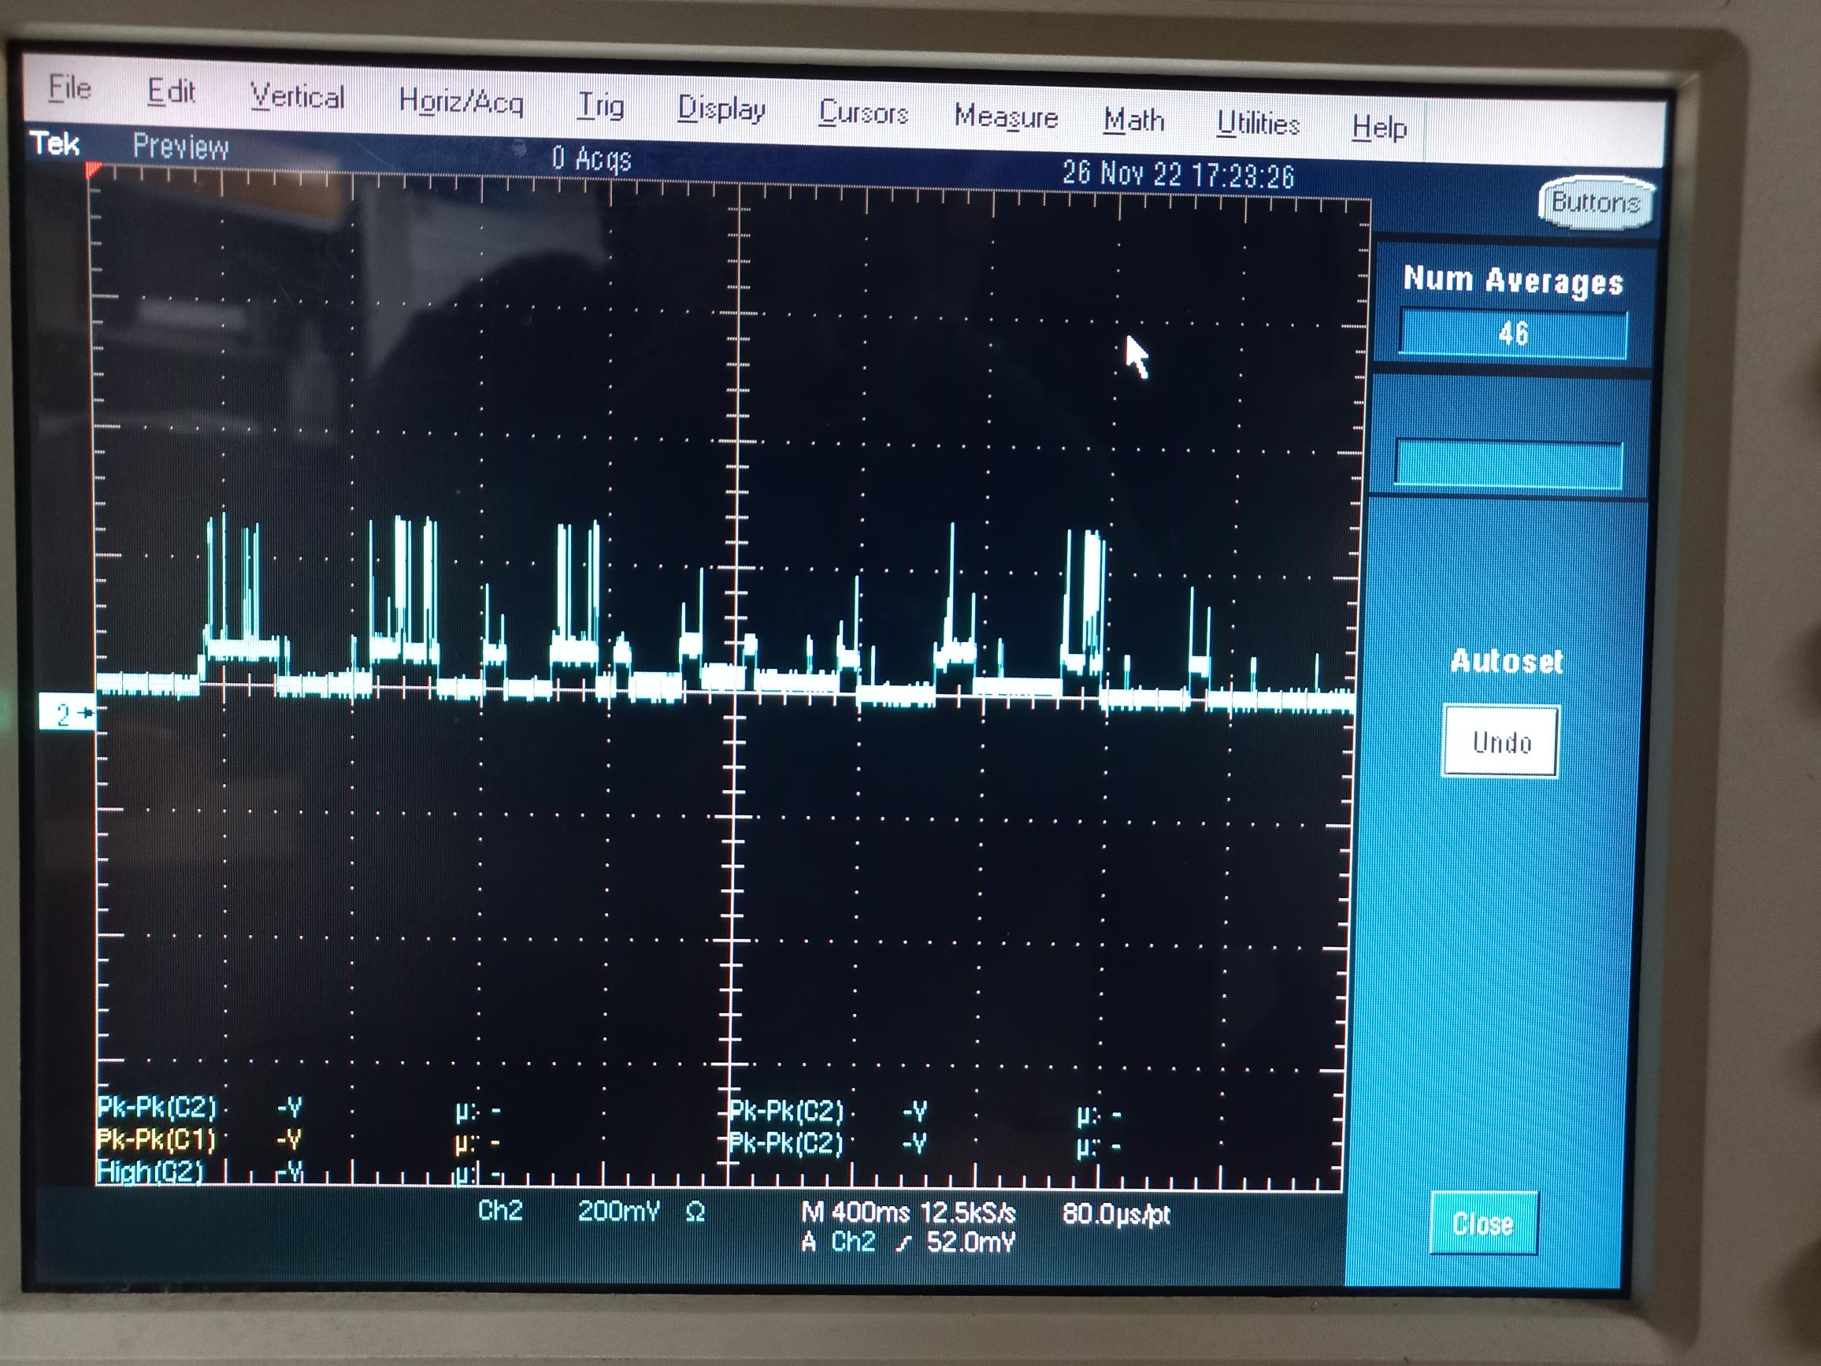

Slide 19
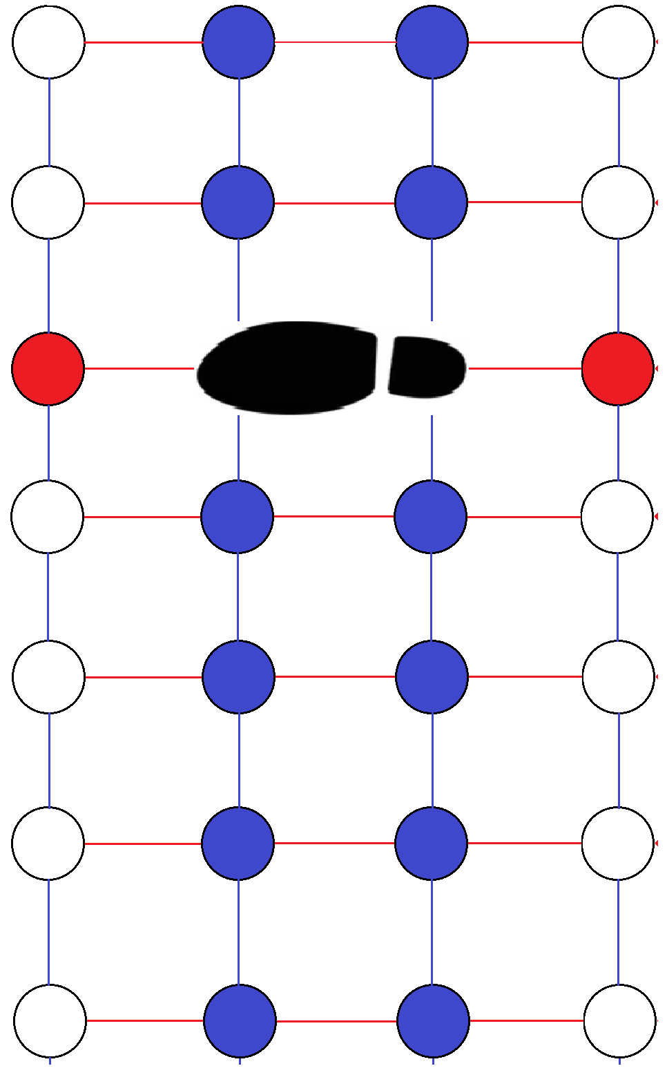
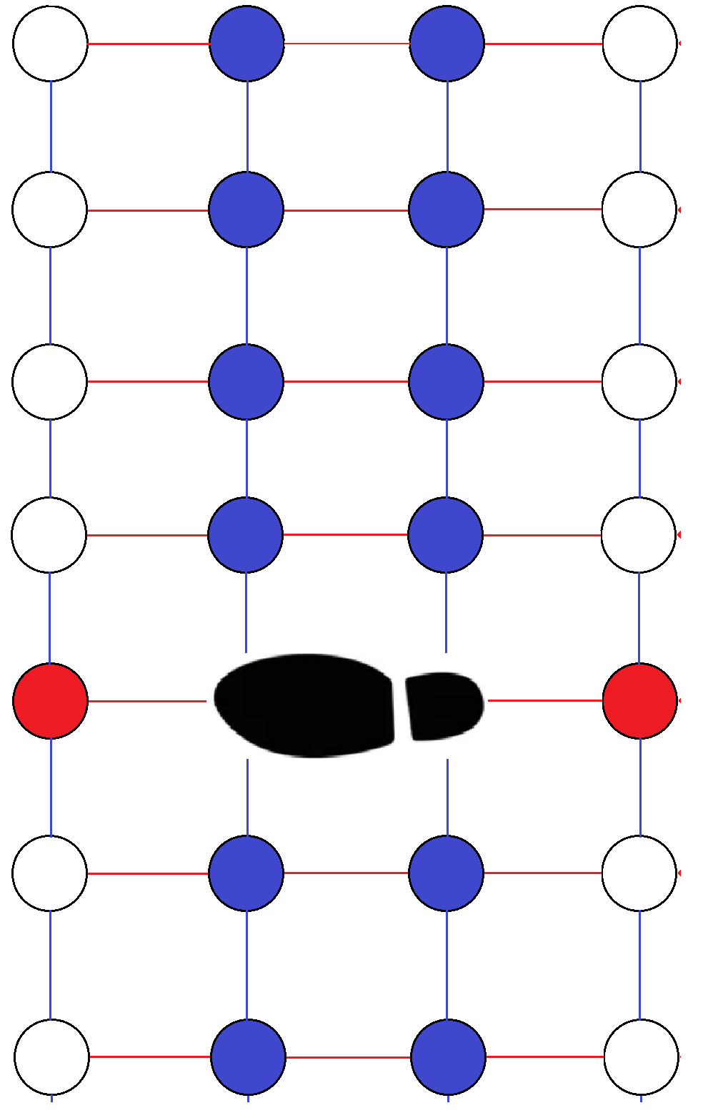


User Authentication
$$1^{st}Step$$
$$2^{nd}Step$$

Slide 20
Hardware
ESP32
-Computes steps and Communicates with smartphone.
TP4056
-Battery charging module.

Slide 21
Software
Arduino IDE
To program ESP32.
Library
WiFi
WiFiClientSecure
UniversalTelegramBot

Slide 22
Demo Plan

Slide 23
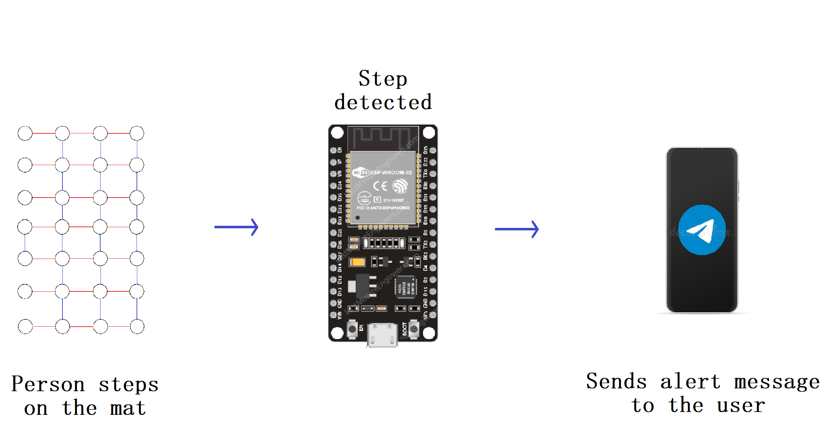

Slide 24
Thank You

